Slide 1
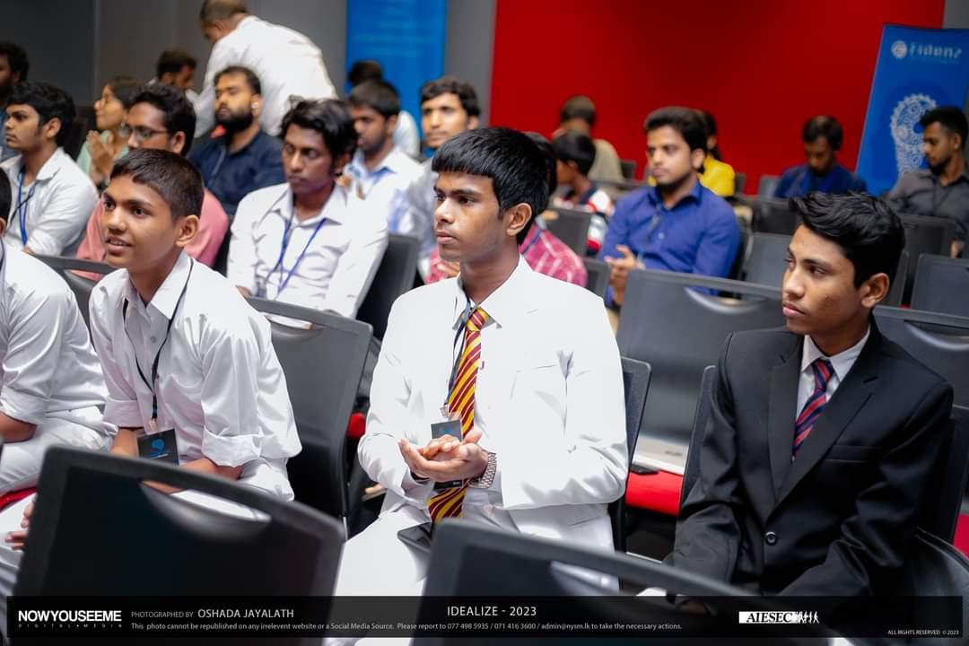


TEAM PROPOSAL
Organized by
AIESEC in University of Moratuwa

Slide 2

IDEALIZE 2024 - Team Proposal
Team Name | M O R K S
Category (web/app) | Web Application
School / open | Open
Name of the web / app | GlamGuide
Field of the web / app | Beauty and Skincare
*Before completing the template please refer proposal guidelines document to understand the submission guidelines.
01

Slide 3
IDEALIZE 2024 - Team Proposal
Problem Definition, Background & Motivation and Proposed Solution
Problem Definition : Limited access to dermatological and aesthetic consultations:
In today's fast-paced world, individuals often struggle to access timely and convenient consultations with dermatologists and beauticians. Traditional methods like in-person appointments can be time-consuming, inconvenient, and geographically restricted. This limited access can lead to delayed diagnoses, untreated skin concerns, and missed opportunities for aesthetic improvement.
Background & Motivation : Increasing demand in self-care and beauty guidance
With the growing emphasis on self-care and beauty, there's an increasing demand for professional guidance. However, access to top-tier makeup artists and dermatologists is often limited by geographic and financial constraints. This web app democratizes access to expert advice, empowering users to make informed decisions about their beauty and skincare routines. By leveraging technology, we make professional consultations accessible, convenient, and affordable.

Slide 4
IDEALIZE 2024 - Team Proposal
Problem Definition, Background & Motivation and Proposed Solution
Solution : Our innovative web application bridges this gap by providing a user-friendly platform for individuals to connect with qualified dermatologists and beauticians for virtual consultations and live streaming sessions. This readily empowers users to
Receive expert advice: Consult with dermatologists and beauticians from the comfort of their homes or anywhere with an internet connection.
Schedule appointments: Easily book and manage consultations at their convenience, eliminating the need for lengthy wait times and travel.
Engage in live consultations: Conduct real-time video consultations with dermatologists and beauticians, allowing for detailed discussions and visual assessments.
Access personalized care: Receive tailored recommendations and treatment plans based on individual needs and concerns.
Routinal guidance: User is prompted into a regular schedule in a daily basis and it is emphasized in a challenging yet user friendly manner to complete each set of routine streakly.

Slide 5
IDEALIZE 2024 - Team Proposal
App / Web Overview , Uniqueness of Web / App
App/Web overview : The web app offers:
User Registration and Profiles: Users can create accounts, manage profiles, and track their session history.
Booking System: An intuitive interface to browse available professionals, check schedules, and book sessions.
Live Sessions: High-quality video streaming for live, interactive makeup and dermatology sessions.
Resource Library: Access to recorded sessions, tutorials, and articles from experts.
Feedback System: Users can rate their sessions and provide feedback to improve the service.
Uniqueness :
Exclusive Access: Direct interaction with renowned makeup artists and dermatologists.
Personalized Sessions: Tailored advice and techniques specific to individual needs and preferences.
Convenience: Flexible booking and live sessions from the comfort of the user's home.
Comprehensive Resources: A combination of live and recorded content for continuous learning.

Slide 6
IDEALIZE 2024 - Team Proposal
IDEALIZE 2024 - Team Proposal
Implementation and Market Plan
Platform Development:
Frontend: User-friendly interface with responsive design using HTML, CSS, and JavaScript (React.js).
Backend: Robust infrastructure using Node.js and Express.js for server-side operations.
Database: Secure data storage with MongoDB or PostgreSQL.
Video Streaming: Integration with platforms like Zoom or liveAPI for live video sessions.
Authentication: Secure login and registration using OAuth 2.0.
Booking System:
Calendar Integration: Users can see available slots and book appointments.
Notifications: Email and SMS reminders for upcoming sessions.
Payment Gateway:
Integration with Stripe or PayPal for secure payment processing.
Admin Dashboard:
Management Tools: Tools for professionals to manage their availability, bookings, and session history.
Testing and Deployment:
Quality Assurance: Rigorous testing to ensure a seamless user experience.
Deployment: Deploying on firebase services
Implementation

Slide 7
IDEALIZE 2024 - Team Proposal
Implementation and Market Plan
Pre-Launch Campaign:
Social Media Teasers: Generate buzz through Instagram, TikTok, and YouTube with sneak peeks.
Influencer Partnerships: Collaborate with beauty influencers to reach a wider audience.
Launch Strategy:
Press Releases: Announce the launch through beauty and tech news outlets.
Launch Event: Virtual event with live demos and Q&A sessions with makeup artists and dermatologists.
Ongoing Marketing:
Content Marketing: Regular blog posts, video tutorials, and success stories from users.
SEO and SEM: Optimize for search engines and run targeted ad campaigns.
Referral Program: Encourage users to invite friends with incentives like discounts on sessions.
Community Engagement:
Social Media Interaction: Active engagement on social media to build a community.
Feedback Loop: Implement user feedback to continuously improve the platform.
Marketing Plan

Slide 8
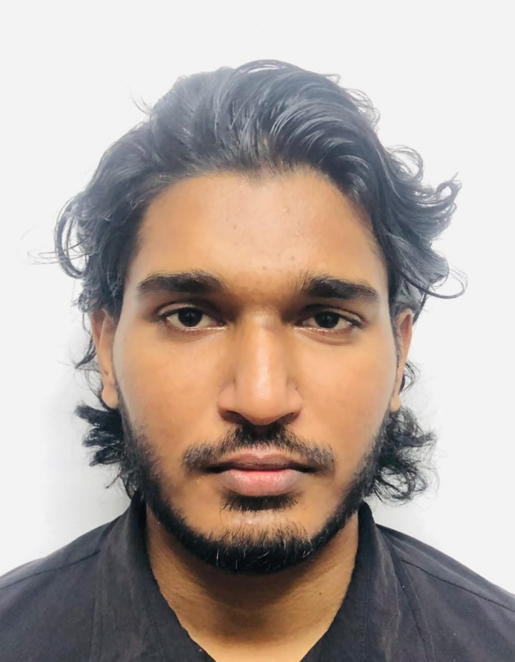
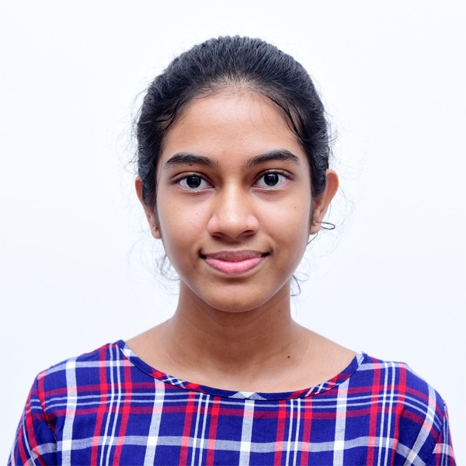
IDEALIZE 2024 - Team Proposal
IDEALIZE 2024 - Team Proposal
Team Details
Shazaan Ashraff
SLIIT malabe
200310701106
mohamedshazaan7@gmail.com
0740754584
Marakkala manage oshadhi imasha
SLIIT malabe
200384211024
oshadhiimasha2@gmail.com
0710753854

Slide 9
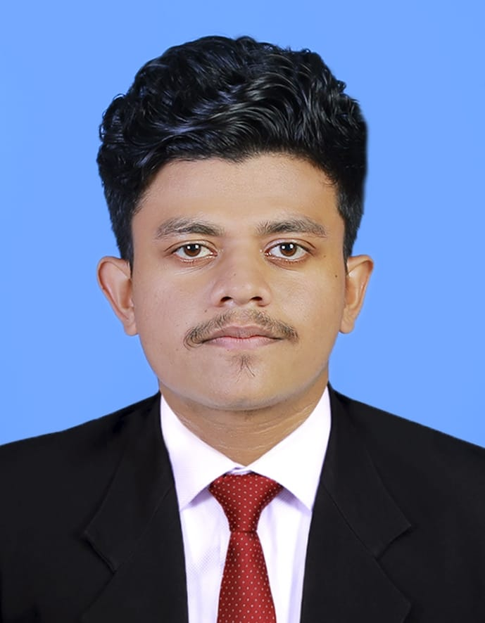
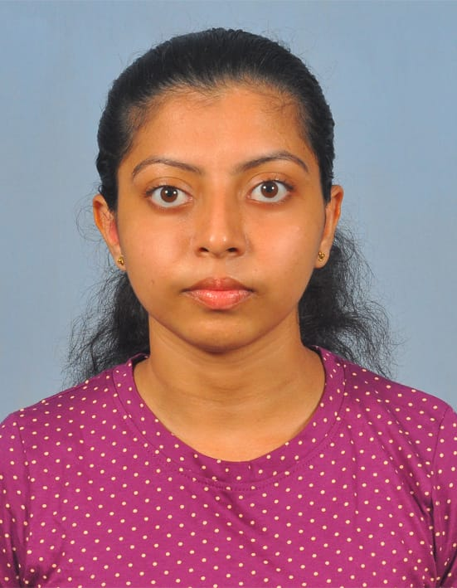
IDEALIZE 2024 - Team Proposal
IDEALIZE 2024 - Team Proposal
Team Details
Hettiyarachige Don Malindu yasanjith gurunadha
SLIIT malabe
200113102697
malinduyasanjith2001@gmail.com
0703075080
Kavithma Hiyanthi Athukorala
SLIIT malabe
200274402469
kavithmaathukorala@gmail.com
0772534601

Slide 10
IDEALIZE 2024 - Team Proposal
IDEALIZE 2024 - Team Proposal
Team Details
Team Member Name
University/School
NIC No
Email
Contact Number
06

Slide 11
IDEALIZE 2024 - Team Proposal

Slide 12
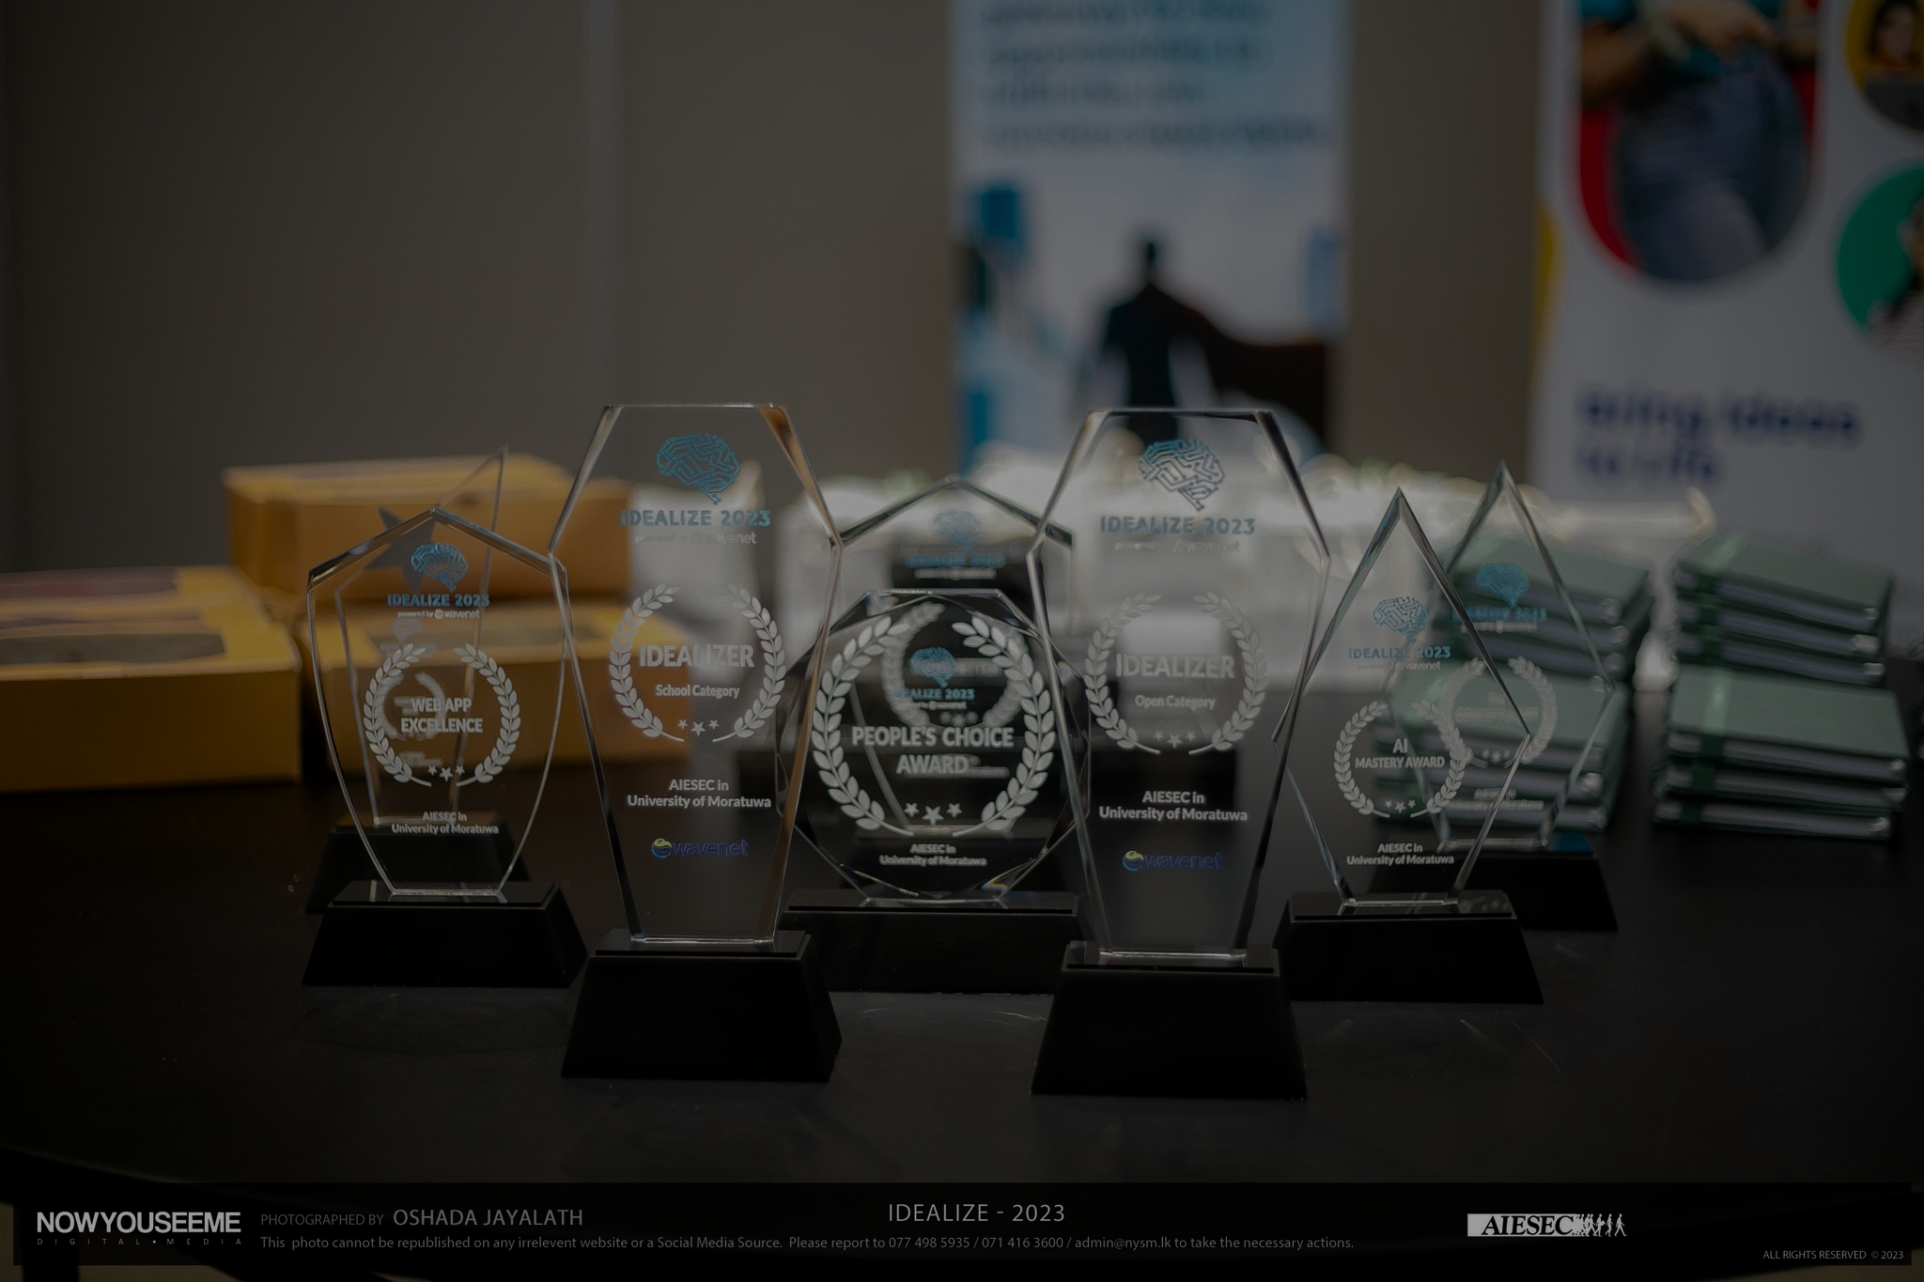
THANK YOU
Organized by
AIESEC in University of Moratuwa

